Slide 1
EXCELLERATE OUTREACH ANALYSIS
This presentation will provide a comprehensive review of our campaign performance dashboards, offering data-driven insights and actionable recommendations to optimize future outreach efforts. By the end, we will have a clear understanding of our current standing and a strategic path forward.
Review All 3 Dashboards
Actionable Recommendations
A detailed look into Campaign Activity, Connectivity Performance, and Student Reach dashboards.
Specific, data-backed strategies to enhance campaign effectiveness and improve student engagement.

Slide 2

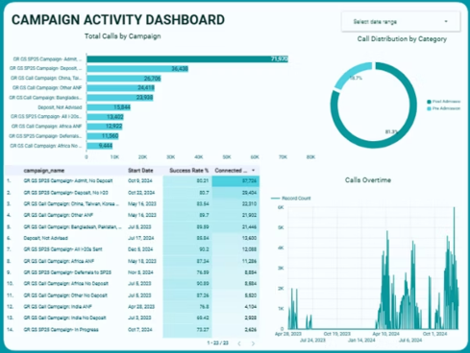


Deep Dive: Campaign Activity Dashboard
The Campaign Activity Dashboard provides a holistic view of our engagement efforts, tracking total calls, category distribution, and trends over time. This data is crucial for understanding where our resources are most effectively deployed.
Total Calls per Campaign
Tracking the volume of outreach for each initiative.
Category Split
Understanding the distribution of calls across different campaign types.
Trends Over Time
Identifying patterns and shifts in campaign activity.
A key finding from this dashboard reveals that Post-Admission campaigns drove a significant 81.3% of total activity, highlighting its critical role in our overall strategy.

Slide 3
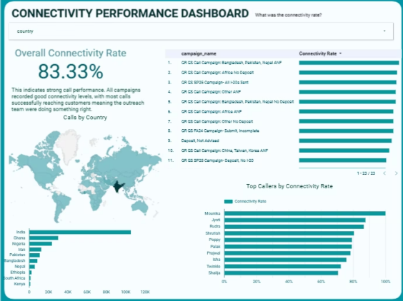
Assessing Outreach Effectiveness: Connectivity Performance Dashboard
The Connectivity Performance Dashboard provides vital insights into the success rate of our outreach, showing how often we successfully connect with students. This metric is fundamental to evaluating the efficiency of our calling efforts.
83.33%
Overall Connectivity
Our current success rate in establishing contact with students.
100%
Top Performer
Mounika consistently achieves perfect connectivity, setting a benchmark for the team.
While the overall connectivity rate stands at a strong 83.33%, we observe variations across campaigns and geographic regions. Top performers like Mounika consistently achieve a 100% connectivity rate, underscoring the potential for higher success across the board.

Slide 4

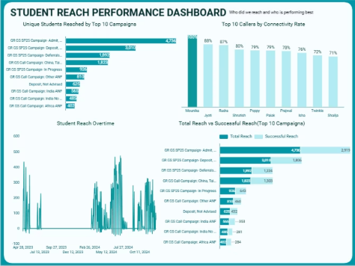
Measuring Impact: Student Reach Performance Dashboard
The Student Reach Performance Dashboard focuses on the ultimate goal: connecting with individual students. It tracks unique students reached, highlights top performers, and visualizes overall reach trends, distinguishing between total and successful connections.
Unique Students Reached
Monitoring the breadth of our outreach efforts across different campaigns.
Top Callers by Connectivity
Identifying individuals who excel at establishing successful contact.
Reach Over Time
Analyzing the evolution of student connections and identifying peak periods.
Total vs. Successful Reach
Distinguishing between attempted contacts and actual connections made.

Slide 5

Key Insights & Strategic Recommendations
Our analysis across all three dashboards has revealed critical insights into our campaign effectiveness, paving the way for targeted improvements and strategic optimizations.
Key Insights
Specific Recommendations
Strong Overall Performance
Recognize & Replicate Top Callers
With an 83.33% connectivity rate, the team is effectively reaching most prospects.
1
Share Mounika and Jyoti's successful scripts and techniques through team training sessions.
Top Performers Stand Out
Mounika, Jyoti, and Rudra consistently achieve 90%+ connectivity rates, showcasing best practices.
Study High-Success Campaigns
2
Identify common factors (timing, script, targeting) from successful campaigns and apply them to others.
Campaign Variation
High-volume campaigns often exhibit high success rates, suggesting replicable strategies.
Focus on Peak Periods
3
Timing & Geography
Strategically increase outreach efforts during high-reach months as indicated by trends.
Volume and success are concentrated in specific months and countries (e.g., India), indicating opportunities for focused efforts.
Geographic Optimization
4
Maintain a strong focus on high-volume countries while carefully testing expansion into new regions.
Improve Low Performers
5
Provide targeted support and additional training for callers and campaigns falling below the 80% connectivity threshold.

